Slide 1

Deep Neural Networks
AIML Module 1
BITS Pilani

Slide 2
The author of this deck is gratefully acknowledging the authors who made their course materials freely available online.

Slide 3
Power of MLP
MLP can be used for
  Classification
    Binary
    Multiclass
  Regression
    real output
  representing complex decision boundaries
  representing boolean functions
MLP is called as Universal Approximator for the above reasons.
Notes:
A one-hot encoding is a vector with as many components as we have categories. The component corresponding to particular instanceʼs category is set to 1 and all other components are set to 0.

Slide 4
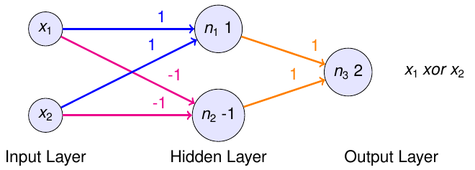
MLP for XOR gate

Slide 5
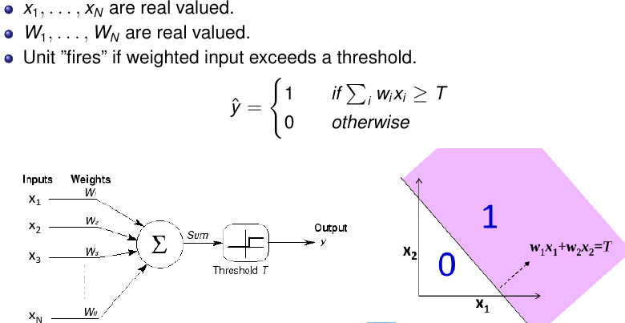
Perceptron with real inputs

Slide 6
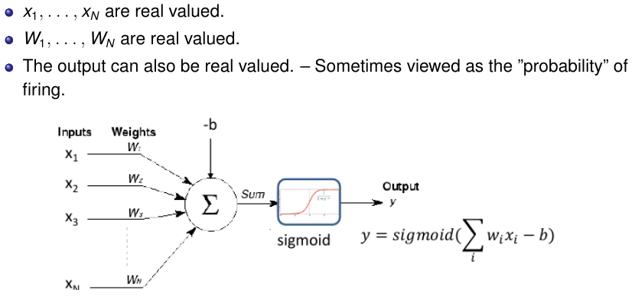
Perceptron with real inputs

Slide 7
Complex Boundaries Using MLP

Slide 8
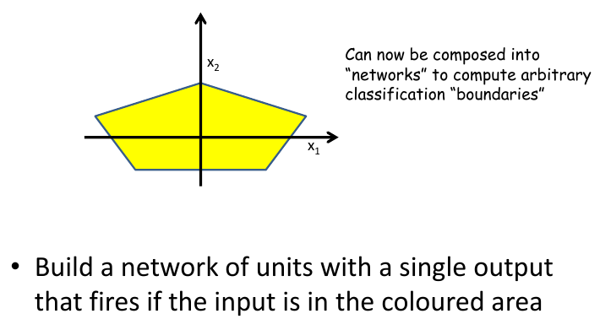
MLP for Complicated Decision Boundaries

Slide 9
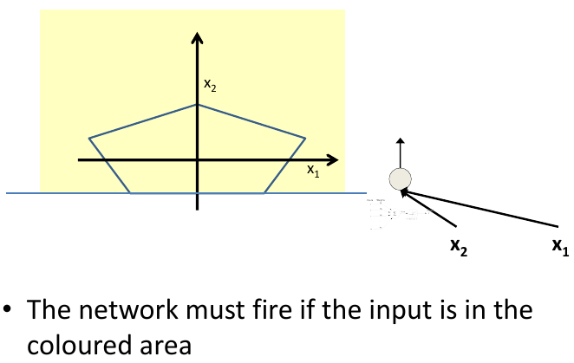
MLP for Complicated Decision Boundaries

Slide 10
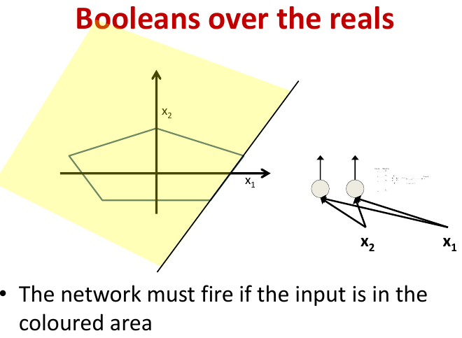
MLP for Complicated Decision Boundaries

Slide 11
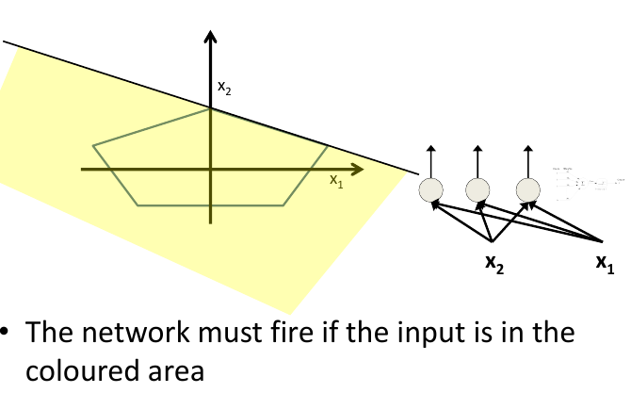
MLP for Complicated Decision Boundaries

Slide 12
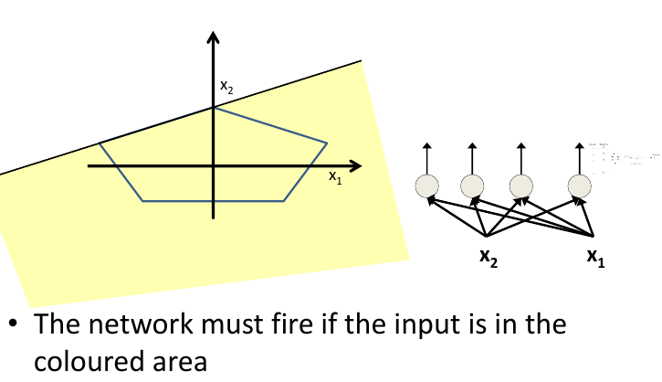
MLP for Complicated Decision Boundaries

Slide 13
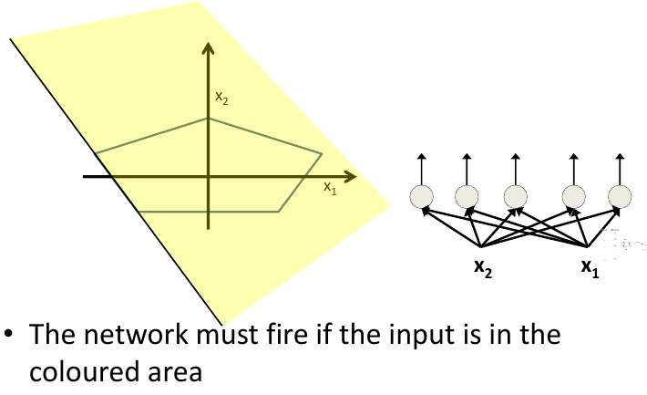
MLP for Complicated Decision Boundaries

Slide 14
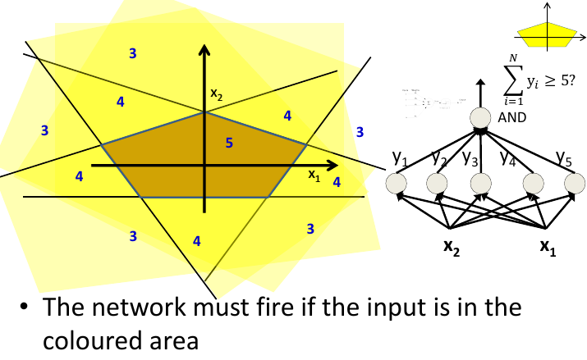
MLP for Complicated Decision Boundaries

Slide 15
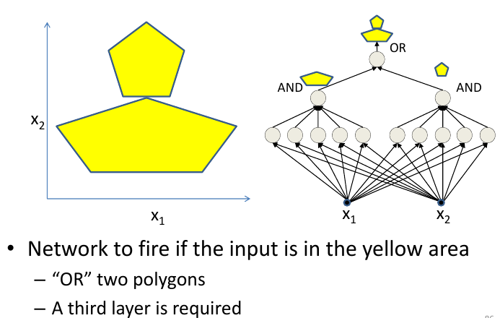
MLP for Complicated Decision Boundaries

Slide 16
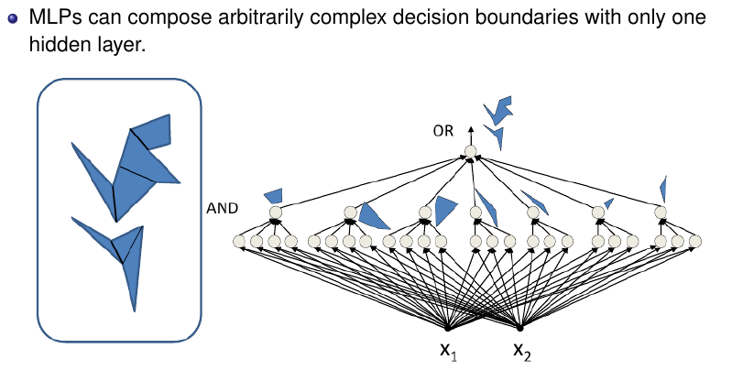
MLP for Complicated Decision Boundaries

Slide 17
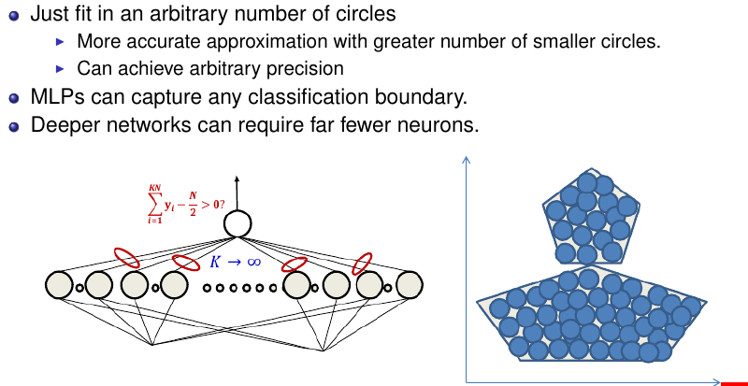
MLPs for Arbitrary Classification Boundary

Slide 18
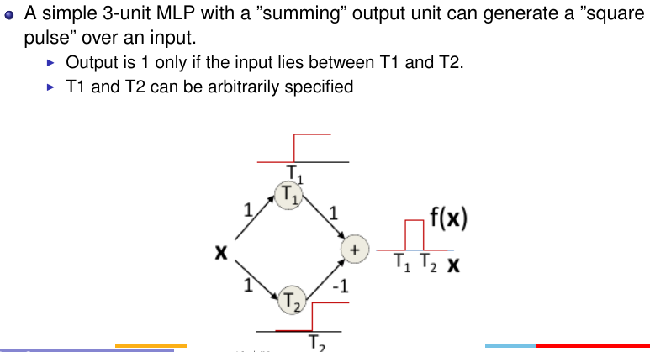
MLP as Continuous-Valued Regression

Slide 19
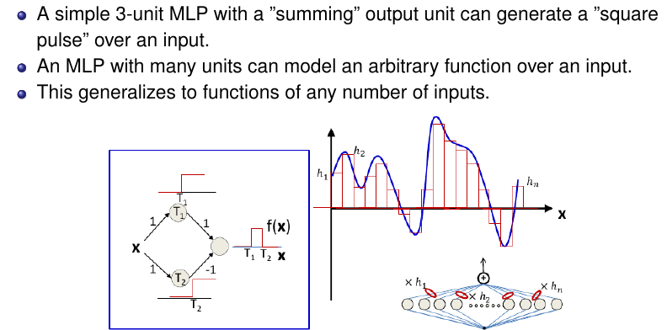
MLP as Continuous-Valued Regression

Slide 20
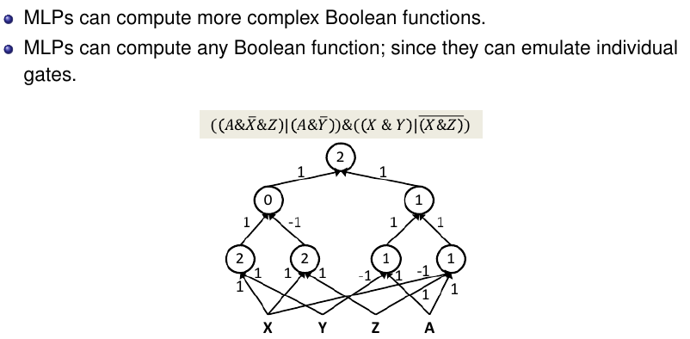
MLPs are Universal Boolean Functions

Slide 21
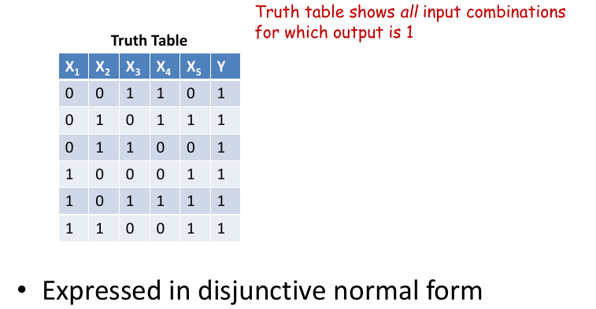
How many layers for a Boolean MLP?

Slide 22
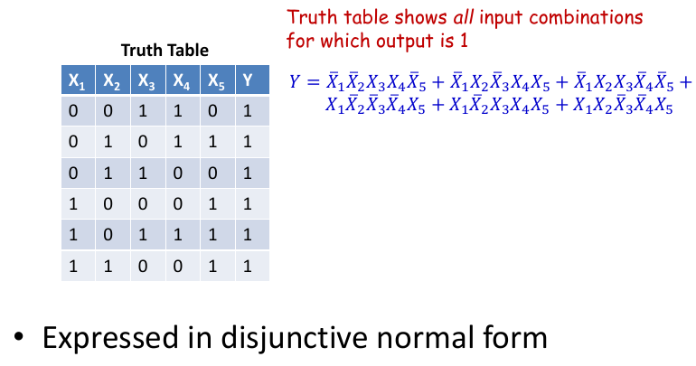
How many layers for a Boolean MLP?

Slide 23
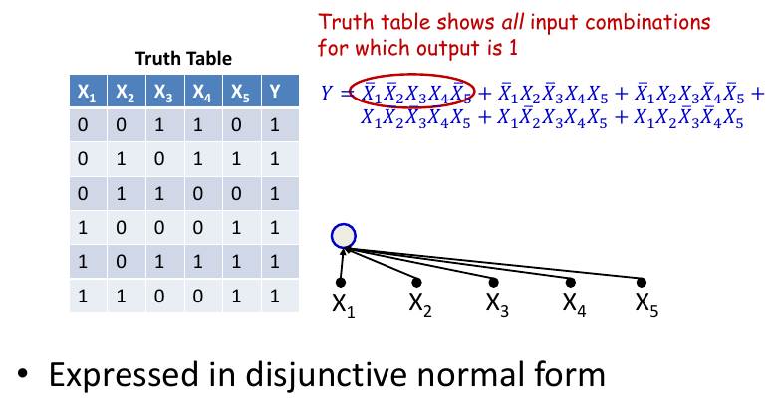
How many layers for a Boolean MLP?

Slide 24
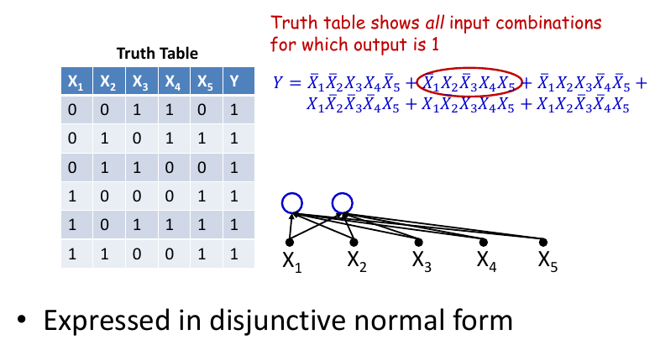
How many layers for a Boolean MLP?

Slide 25
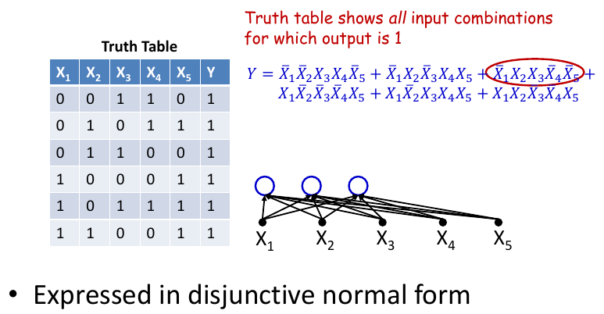
How many layers for a Boolean MLP?

Slide 26
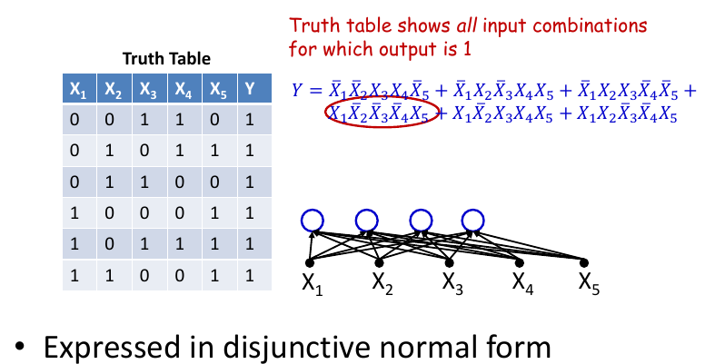
How many layers for a Boolean MLP?

Slide 27
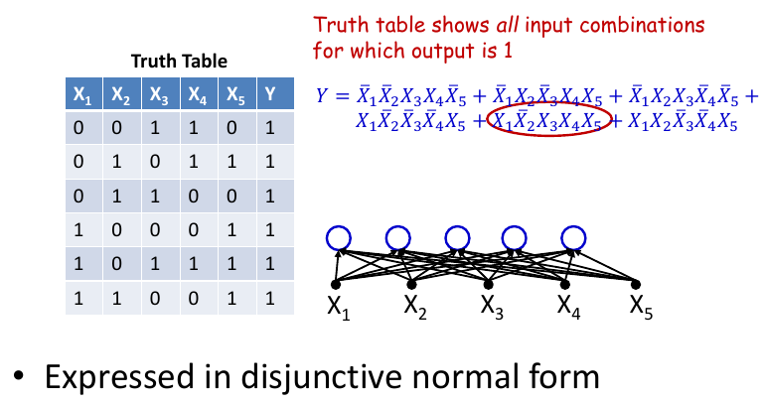
How many layers for a Boolean MLP?

Slide 28
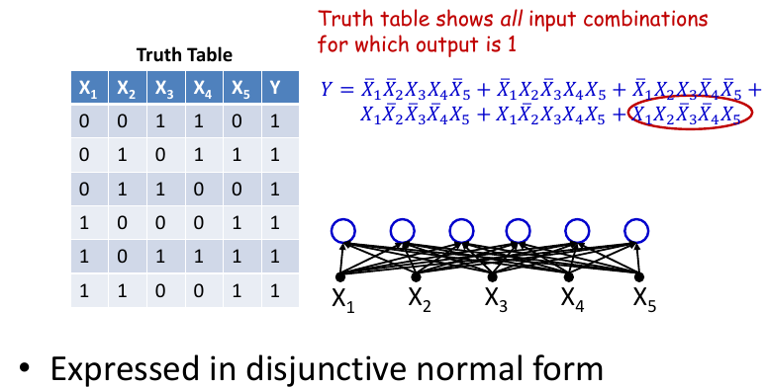
How many layers for a Boolean MLP?

Slide 29
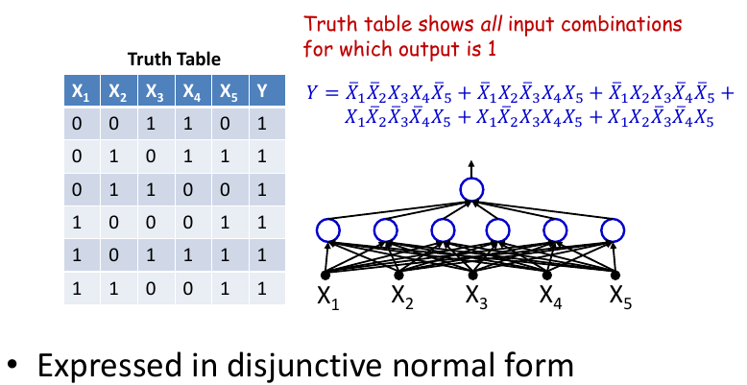
How many layers for a Boolean MLP?

Slide 30
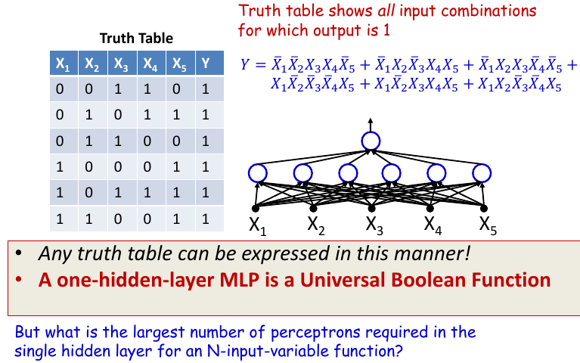
How many layers for a Boolean MLP?

Slide 31
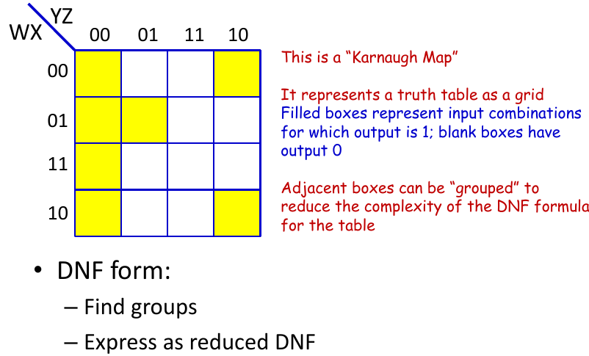
Reducing a Boolean Function

Slide 32
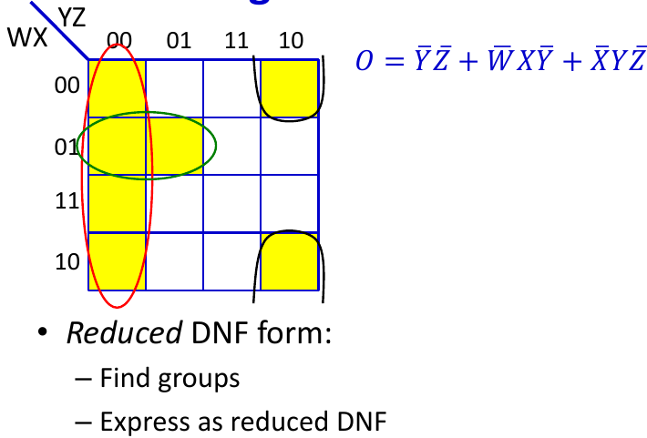
Reducing a Boolean Function
Notes:
Note: Multiple answers are possible

Slide 33
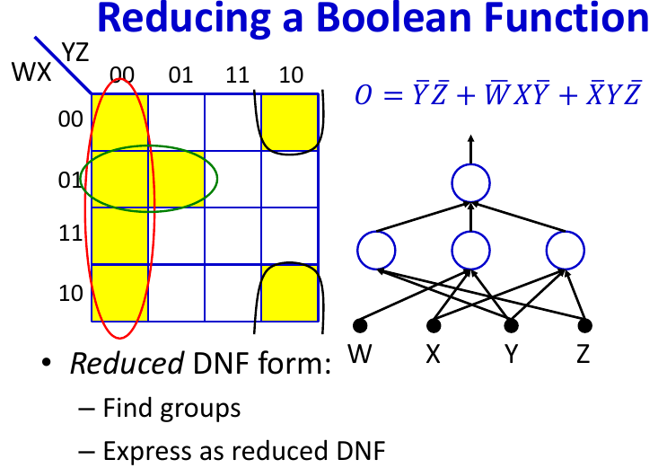
Reducing a Boolean Function

Slide 34
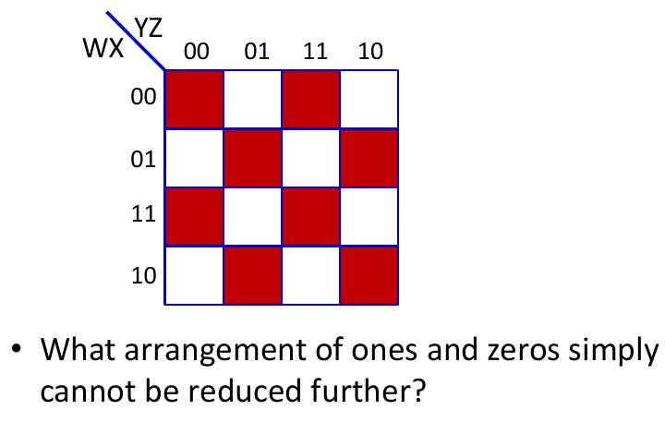
Largest irreducible DNF?
Notes:
DNF -disjunctive normal form

Slide 35
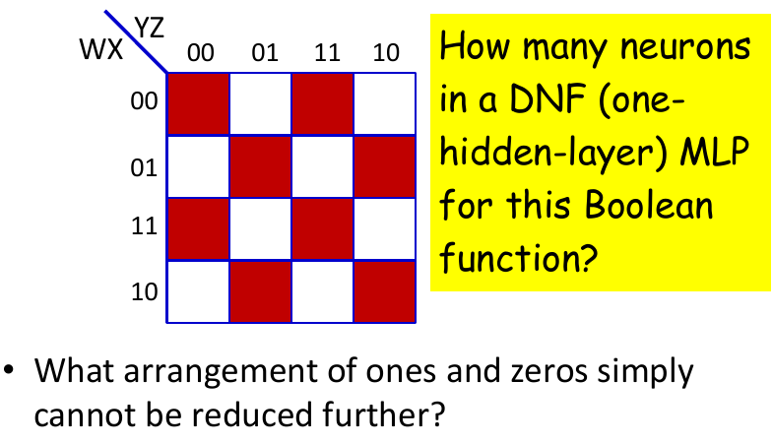
Largest irreducible DNF?

Slide 36
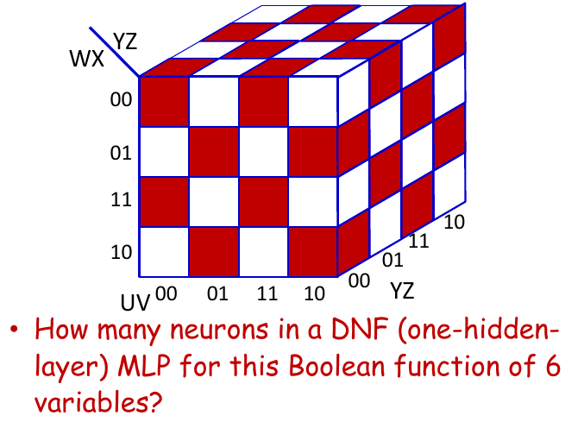
Width of a Single Layer Boolean MLP

Slide 37
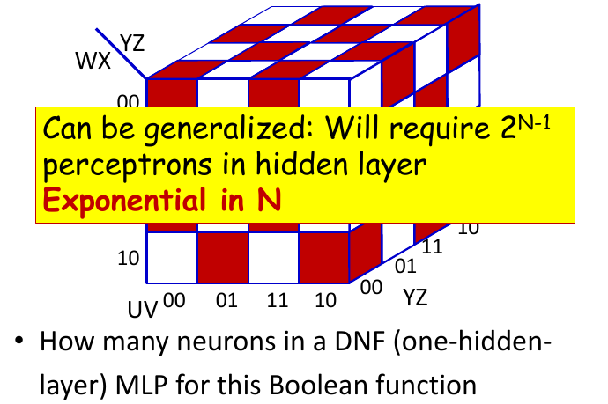
Width of a Single Layer Boolean MLP

Slide 38
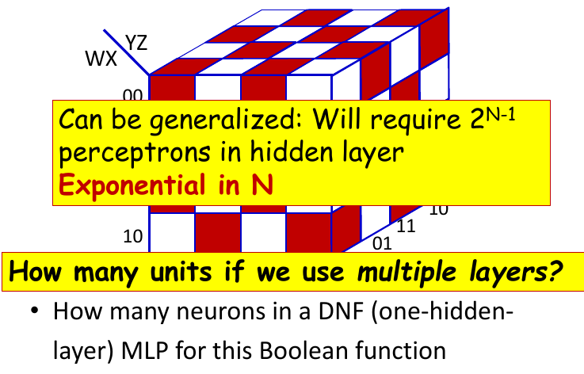
Width of a Single Layer Boolean MLP

Slide 39
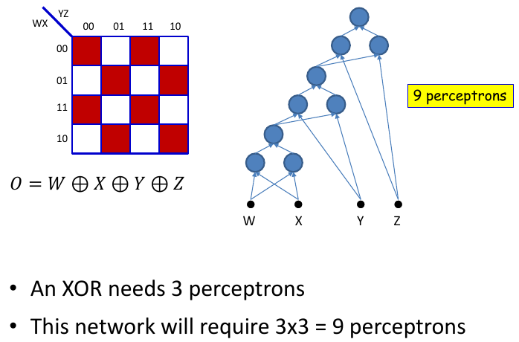
Width of deep MLP

Slide 40
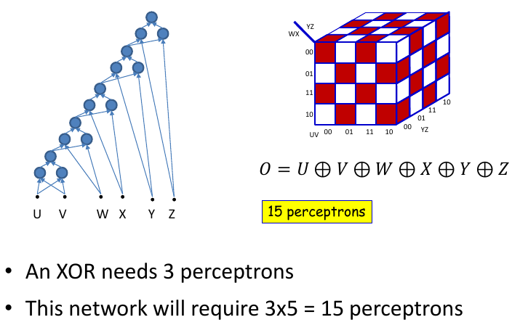
Width of deep MLP

Slide 41
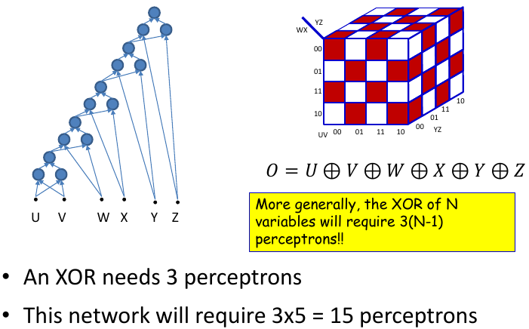
Width of deep MLP

Slide 42
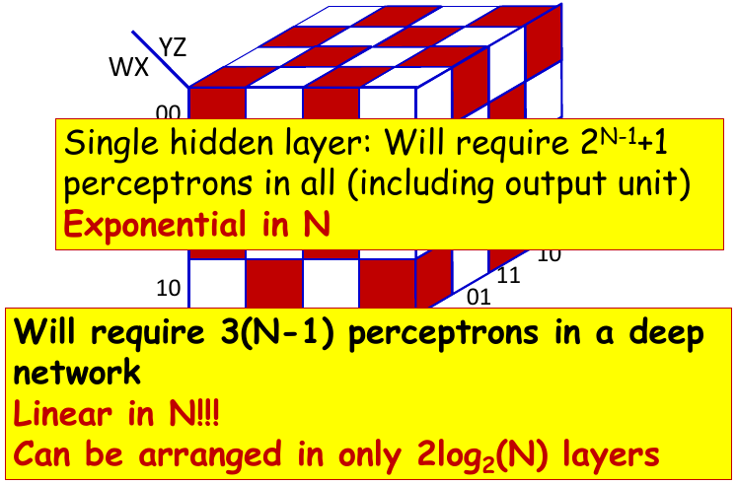
Width of Single Layer Boolean MLP

Slide 43
Summary of MLP
MLPs are connectionist computational models,
  Individual perceptrons are computational equivalent of neurons.
  The MLP is a layered composition of many perceptrons.
MLP can model universal Boolean functions
  Individual perceptrons can act as Boolean gates.
  Networks of perceptrons are Boolean functions.
MLPs are Boolean machines.
  They represent Boolean functions over linear boundaries.
  They can represent arbitrary decision boundaries.
  They can be used to classify data.
MLP can model continuous valued functions.
MLPs as universal classifiers.
MLPs as universal approximators.

Slide 44
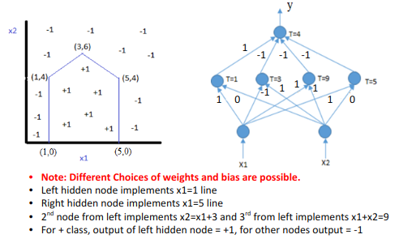
Exercise

Slide 45
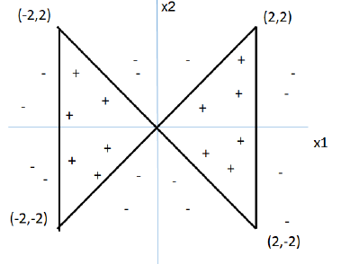
Exercise
(x1, x2) are input features and target classes are either +1 or -1 as shown in the figure.
A. What is the minimum number of hidden layers and hidden nodes required to classify the following dataset with 100% accuracy using a fully connected multilayer perceptron network? Step activation functions are used at all nodes, i.e., output=+1 if total weighted input >= bias b at a node, else output = -1.
B. Show the minimal network architecture by organizing the nodes in each layer horizontally. Show the node representing x1 at the left on the input layer. Organize the hidden nodes in ascending order of bias at that node. Specify all weights and bias values at all nodes. Weights can be only -2.5, 2.5 or 0, and bias +ve/-ve multiples of 2.5.
Notes:
Instruct the students to solve on their own

Slide 46
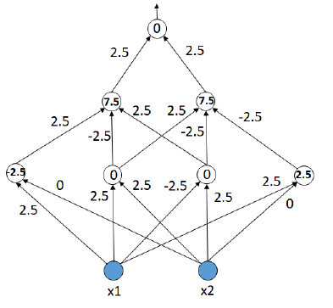
Solution
A. 2 hidden layers, 4 nodes in first hidden layer and 2 nodes in second hidden layer needed.
B.

Slide 47
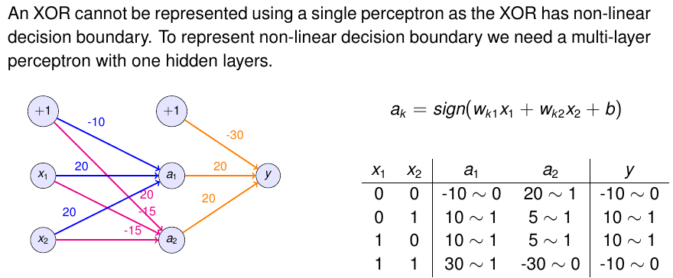
An XOR cannot be represented using a single perceptron. If this statement is true, demonstrate the alternative way to represent XOR using an ANN.

Slide 48
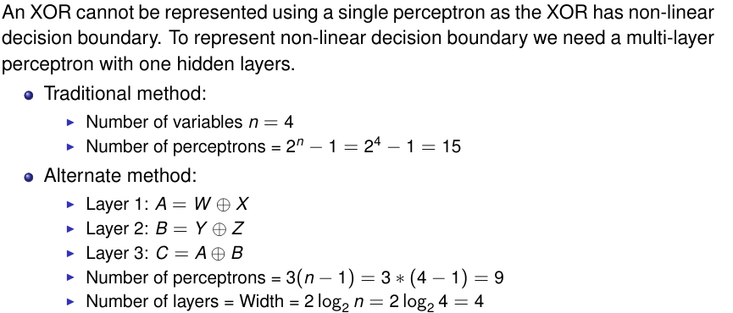
How many perceptrons are required to represent W ⊕ X ⊕ Y ⊕ Z ?

Slide 49
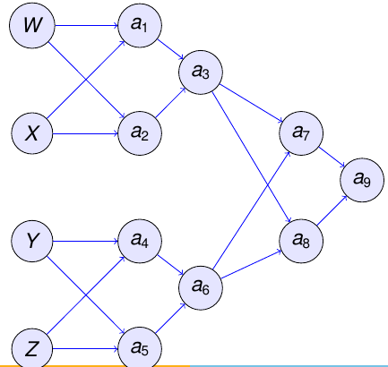
How many perceptrons are required to represent W ⊕ X ⊕ Y ⊕ Z ?

Slide 50
Thank you

